Slide 1
METHOD OVERRIDING

Slide 2
METHOD OVERRIDING
If subclass (child class) has the same method as declared in the parent class, it is known as method overriding in java.
Usage of Java Method Overriding:
Method overriding is used to provide specific Implementation of a method that is already provided by its super class.
Method overriding is used for runtime polymorphism

Slide 3
Rules for Java Method Overriding
Method must have same name as in the parent class.
Method must have same parameter as in the parent class.
Must be IS-A relationship (inheritance).

Slide 4
class Vehicle
{
void run(){System.out.println("Vehicle is running");}
}
class Bike2 extends Vehicle
{
void run(){System.out.println("Bike is running safely");
}
public static void main(String args[])
{
Bike2 obj = new Bike2();
obj.run();
} Output: Bike is running safely

Slide 5
Real Example of Java Method Overriding
Consider a scenario, Bank is a class that provides functionality to get rate of interest. But, rate of interest varies according to banks. For example, SBI, ICICI and AXIS banks could provide 8%, 7% and 9% rate of interest.
Notes:
Test2.java

Slide 6
We cannot override static method:
because static method is bound with class whereas instance method is bound with object. Static belongs to class area and instance belongs to heap area.

Slide 7
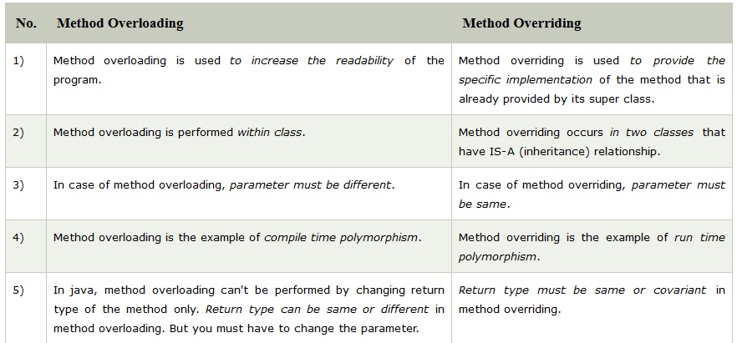
Difference Between Method Overriding & Method Overloading

Slide 8
POLYMORPHISM
Polymorphism in java is a concept by which we can perform a single action by different ways.
Polymorphism is derived from 2 greek words: poly and morphs. The word "poly" means many and "morphs" means forms. So polymorphism means many forms.

Slide 9
TYPES OF POLYMORPHISM
There are two types of polymorphism in java:
1. Compile time polymorphism: Method Overloading.
2. Runtime polymorphism: Method Overriding.

Slide 10
RunTime Polymorphism
Runtime polymorphism or Dynamic Method Dispatch is a process in which a call to an overridden method is resolved at runtime.
In this process, an overridden method is called through the reference variable of a superclass.

Slide 11
Upcasting
When reference variable of Parent class refers to the object of Child class, it is known as upcasting.
class A{ }
class B extends A{ }
A a=new B(); //upcasting
Notes:
TestPolymorphism2.java

Slide 12
Example of Java Runtime Polymorphism
class Bike{
void run(){System.out.println("running");}
}
class Splender extends Bike{
void run(){System.out.println("running safely with 60km");}
public static void main(String args[]){
Bike b = new Splender();//upcasting
b.run();
}
} Output:running safely with 60km.

Slide 13
Java Runtime Polymorphism with Data Member
Method is overridden not the datamembers, so runtime polymorphism can't be achieved by data members.
class Bike
{
int speedlimit=90;
}
class Honda3 extends Bike
{
int speedlimit=150;
public static void main(String args[])
{
Bike obj=new Honda3();
System.out.println(obj.speedlimit); //90
}
}

Slide 14
Upcasting is casting to a supertype, while downcasting is casting to a subtype.
Upcasting is always allowed, but downcasting involves a type check and can throw a ClassCastException.
Upcasting: happens automatically, no need to do anything explicitly.
Downcasting : is not directly possible in Java, explicitly we have to do.

Slide 15
Downcasting with java instanceof operator
When Subclass type refers to the object of Parent class, it is known as downcasting.
If we perform it directly, compiler gives Compilation error.
If you perform it by typecasting, ClassCastException is thrown at runtime.
But if we use instanceof operator, downcasting is possible.

Slide 16
class Animal{ }
class Dog1 extends Animal
{ //Dog inherits Animal
public static void main(String args[])
{
Dog1 d=new Dog1();
System.out.println(d instanceof Animal);//true
}
}

Slide 17
Dog d=new Animal();//Compilation error
If we perform downcasting by typecasting, ClassCastException is thrown at runtime.
Dog d=(Dog)new Animal();
//Compiles successfully but ClassCastException is thrown at runtime

Slide 18
Possibility of downcasting with instanceof
class Animal { }
class Dog3 extends Animal {
static void method(Animal a) {
if(a instanceof Dog3)
{
Dog3 d=(Dog3)a; //downcasting
System.out.println ("ok downcasting performed");
}
}
public static void main (String [] args) {
Animal a=new Dog3();
Dog3.method(a);
}
}

Slide 19
Downcasting without the use of java instanceof
class Animal { }
class Dog4 extends Animal {
static void method(Animal a) {
Dog4 d=(Dog4)a;//downcasting
System.out.println("ok downcasting performed"); }
public static void main (String [] args) {
Animal a=new Dog4();
Dog4.method(a);
}
}

